Slide 1
Treatment Of Domestic Sewage Using Upflow Anaerobic Sludge Blanket(UASB) Reactor
CEC 4980 Project A
Presented by : Aryan Varshney and Shishir Yadav
Mentored by : Dr. Farrukh Basheer

Slide 2
Overview
Introduction
Objective
Preliminary Treatment
UASB Reactor
Facultative type Aerated Lagoon
Design of Treatment units for 10 MLD Domestic Sewage
References

Slide 3
Introduction
As the global population is so large and growing, so does the sewage.
As the natural water treatment process is overloaded, there is need for sewage treatment facilities.
The motive behind treatment of sewage is to purify water as much as possible with effective techniques to keep humans and the earth safe and thriving.
India will have the largest population in coming years and it is projected that India’s wastewater treatment market will reach to USD 4.3 billion by 2025 owing to increasing demand of sewage treatment plants across the country, according to NITI Aayog.
There are various methods to treat sewage. We are going to discuss about treatment of sewage by upflow anaerobic sludge blanket reactor.

Slide 4
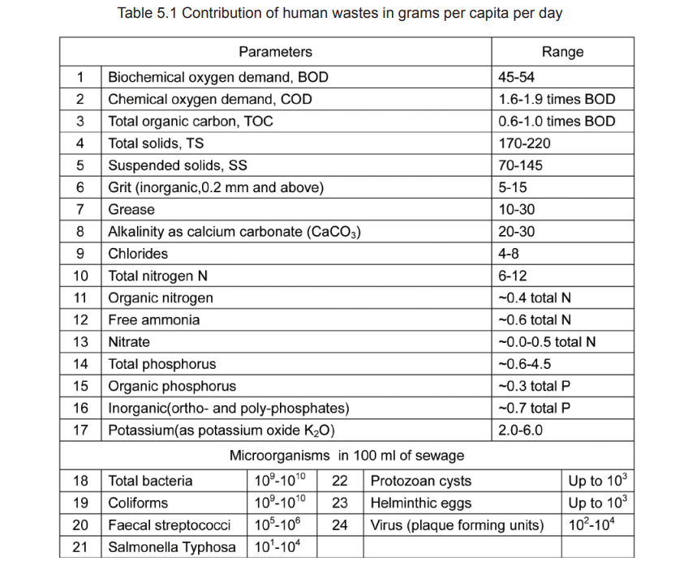
Contribution of human wastes

Slide 5
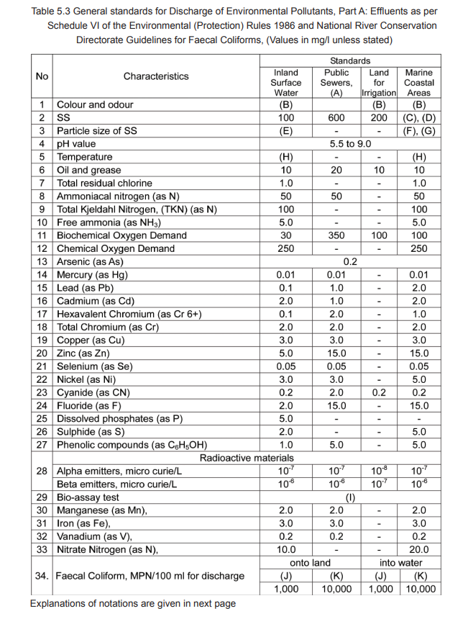
General Standards of Discharge of Pollutants

Slide 6
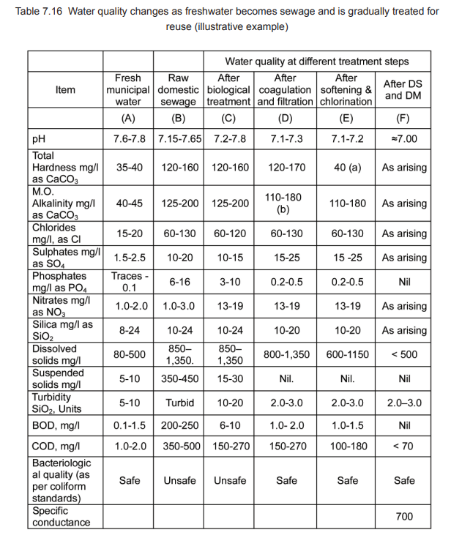
Water Quality Changes

Slide 7
Objective
The major objectives of UASB process are:
Pre-sedimentation anaerobic wastewater treatment and final sedimentation including sludge stabilization are essentially combined in one reactor making it most attractive high rate waste water treatment option.
To produce by products like methane enriched biogas as a source of energy and nutrient rich sludge.
Management of carbon credits and low consumption of energy.

Slide 8
Preliminary Treatment
The objective of preliminary treatment is the removal of coarse solids and other large materials often found in raw sewage.
Removal of these is necessary to enhance the operation and maintenance of subsequent treatment units.
It includes pumping, coarse screening, grit removal and flow measuring devices.
We have adopted units of pumping, approach channel, screening and grit removal for preliminary treatment of sewage.
The pumping chamber will receive the raw sewage to pass to screens by approach channel and subsequently to the grit chamber.
Then it goes to UASB for further treatment.

Slide 9
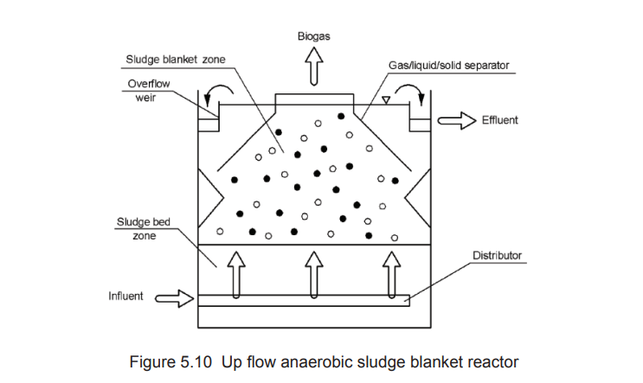
UASB Reactor
In this process, the waste water is passed through the anaerobic reactor in an upflow mode.
The up flowing sewage itself forms millions of small granules of sludge which are in suspension and the excess sludge is removed and taken to the sludge beds.
Organic compounds get anaerobically biodegraded converting it into methane enriched biogas.
It internally separates gas, liquid and solid and reduction of COD by 70-80%, of TSS by 70-80% and of pathogens by 70-90%.

Slide 10
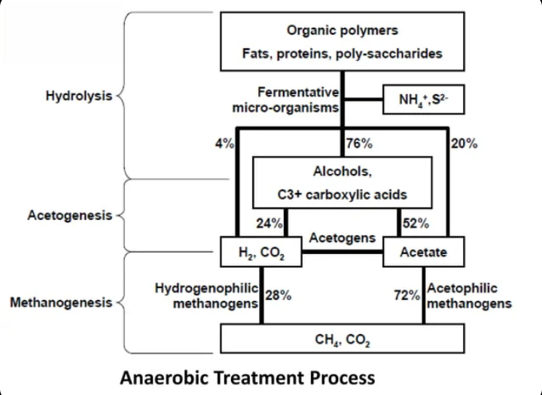
Anaerobic Process

Slide 11
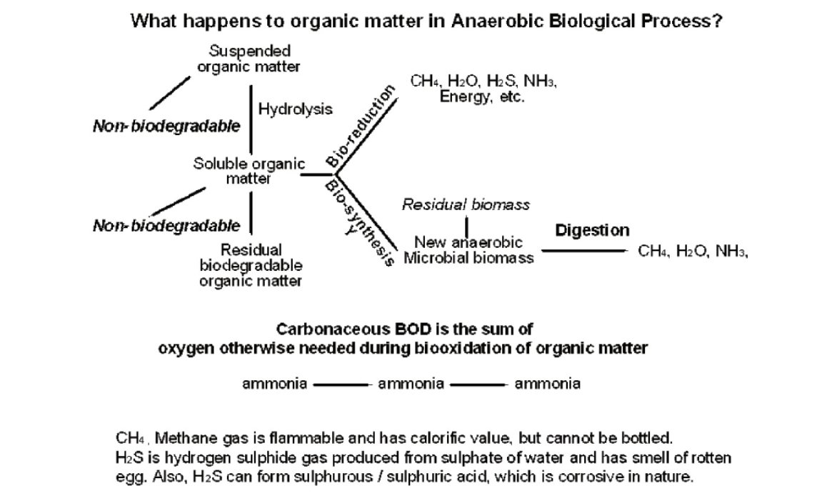
Anaerobic Process

Slide 12
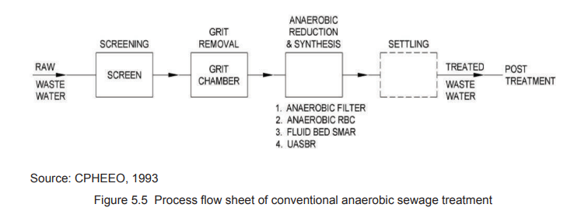
Facultative type Aerated Lagoon
The flow from UASB will be directed to aerated lagoon to provide aeration and allow further settlement of suspended solids of the effluents from the UASB reactors.
This aerator provides the oxygen to be decomposed along with water. This resulting induction of oxygen reduces the BOD load by further 75%.
Detention period is taken to be 1 day.

Slide 13
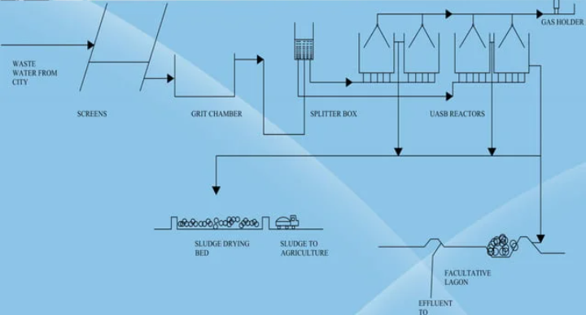
Treatment Scheme

Slide 14
Design of Treatment Units for 10 MLD Domestic Sewage

Slide 15

Design of Pump House
Q_{avg} = 10 MLD = 10⁴ m³/d = 0.116 m³/s
Max. sewage flow, Q_{max} = $2∗0.116$= 0.232 m³/s
Assuming Min. flow as 40% of average flow,
Q_{min} = $0.4∗0.116$= 0.046 m³/s
Design of rising main:
Assuming 1m/s as the flow through velocity in the rising main, the cross sectional area of the rising main at peak flow, A= flow / velocity
A = 0.232 m²
Diameter of the rising main, d_{r} = $\sqrt{(4∗A)/π}$ = 0.54 m
Provide a rising main of 550 mm diameter and area = 0.23 m²

Slide 16

Design of Pump House
Design of sump well (wet well):
Assuming that the sump well retains the flow of waste water for 20 min.,
the maximum quantity of sewage in the sump, $Qmax∗t=0.232∗20∗60=278.4 m3$
Quantity of sewage in a rising main of 200 m length $=200∗0.23=46 m3$
Total Capacity of the sump required $=278.4+46=324.4 m3=325 m3$
Assuming a max. of 4 m depth of the sump,
the surface area of the sump, As = $\frac{325}{4}$ = 81.25 m²
Providing 3 sump wells for 3 pumps, 2 working and 1 standby (2W+1S), such that 2 wells will always remain in operation when one of the wells is taken under repair or maintenance. The surface area of one sump is $\frac{81.25}{2}=40.625 m2$

Slide 17

Design of Pump House
Diameter of each sump, d_{s} = $\sqrt{4∗40.625/π}=7.2 m$
To determine minimum liquid depth in the sump well, $Qmin in the well+flow in rising main$
Assuming 20 min. detention time, $Qmin∗t=0.046∗20∗60=55.2 m3$
Minimum volume of liquid in the well = $55.2+46=101.2 m3$
Area of one wet well $=\frac{π}{4}∗7.22=40.7 m2$
Minimum liquid depth in each well $=\frac{101.2}{40.7}=2.5 m$
Design of Dry well:
A dry well is designed on the basis of the space equal to that is required for housing the working as well as standby pumps. Normally one can assume the same dimensions as that for a wet well. Additional space is provided for ladder and working area of maintenance.

Slide 18

Design of Pump House
Design of pumps:
Providing 3 pumps, 2 in operation and 1 as standby, the maximum flow that each pump has to lift, $Qpump=\frac{0.232}{2}=0.116 m3/s$
Frictional losses in pipe, $hf=\frac{flv2}{2gd}=\frac{0.01∗200∗12}{2∗9.81∗0.54}=0.19 m$ (Assuming $f=0.01$)
Assuming losses in bends, etc. = 0.5 m
Total Head, $H=Pumping Head+Head losses$
Assuming sewage is to pumped against a head of 8 m,
$H=8+0.19+0.5=8.69 m≅9 m$
Power required $=\frac{W∗Q∗H}{75∗ηp∗ηm}=\frac{1000∗0.116∗9}{75∗0.7∗0.8}=24.8 BHP \sim 25 BHP$ (Assuming $ηp=70\%, ηm=80\%$)
Total Power required $=2∗25=50 BHP$
Provide 3(2W+1S) pumps, each of 25 BHP for each well.

Slide 19

Design of Power House
Design of Suction Pipe:
Max. flow in the pipe for each wet well $=0.116 m3/s$
Assuming velocity of flow in the pipe, $v=1 m/s$, the cross sectional area of the intake pipe, $Ax=\frac{0.116}{1}=0.116 m2$
Diameter of suction or inlet pipe, $din=\sqrt{4∗0.116/π}=0.38 m \sim 0.4 m$
Provide 400 mm diameter pipes.
Approximate length of pump house $=7.2+7.2+7.2≅25 m$
Approximate width of pump house $=7.2+7.2+5≅20 m$

Slide 20

DESIGN OF APPROACH CHANNEL
Providing two channels in one unit
$$Qmax =20/2=10 MLD=104 m3/d=0.116 m3/d$$
A_{x} = $\frac{0.116}{1}=0.116 m2$ (Assuming $v=1 m/s$)
$b/d=1.5/1$ $⟹1.5∗d2=0.116$
$$d=0.278 m≅0.3 m$$
$$b=1.5∗0.3=0.45 m$$
Provide net depth , $d=0.3 m$and width ,$b=0.45 m$
Area $=0.3∗0.45=0.135 m2$
Assuming free board is 0.3 m, the total depth of tank, $Df=0.3+0.3=0.6 m$

Slide 21

DESIGN OF APPROACH CHANNEL
Assuming length of the channel as 2 m, so provide a 2 m long channel of 0.45 m width and 0.6 m depth
Dimension$−(2∗0.45∗0.3+0.3 FB)$
Assuming slope of channel as 1:1000 and $n=0.012$ for cement concrete (Manning’s roughness coefficient)
Wetted perimeter of the channel $=2D+B=2∗0.3+0.45=1.05 m$
Hydraulic mean radius , $R=\frac{A}{P}=\frac{0.135}{1.05}=0.1286 m$
$vh=\frac{1}{n}∗R2/3∗s1/2=\frac{1}{0.012}∗(0.1286)2/3∗(0.001)1/2=0.671 m/s <vh= 1 m/s$(Assumed)
Again, Assuming slope of channel as 1:250 and n = 0.015

Slide 22

DESIGN OF APPROACH CHANNEL
$vh=\frac{1}{0.015}∗(0.1286)2/3∗(1/250)1/2=1.074 m/s >vh=1 m/s$ (Assumed)
Hence OK
Check for flow at one-third depth $D/3=0.3/3=0.1 m$
Cross sectional area $=0.1∗0.45=0.045 m2$
Wetted perimeter $=2D+B=2∗0.1+0.45=0.65 m$
Hydraulic mean radius $=\frac{A}{P}=\frac{0.045}{0.65}=0.0692 m$
Velocity at $\frac{D}{3}=\left(\frac{1}{n}\right)∗R2/3∗S1/2=1/0.015∗(0.0692)2/3∗(1/250)1/2$
$(vh)d/3=0.711 m/s>0.5 m/s$(min velocity)

Slide 23
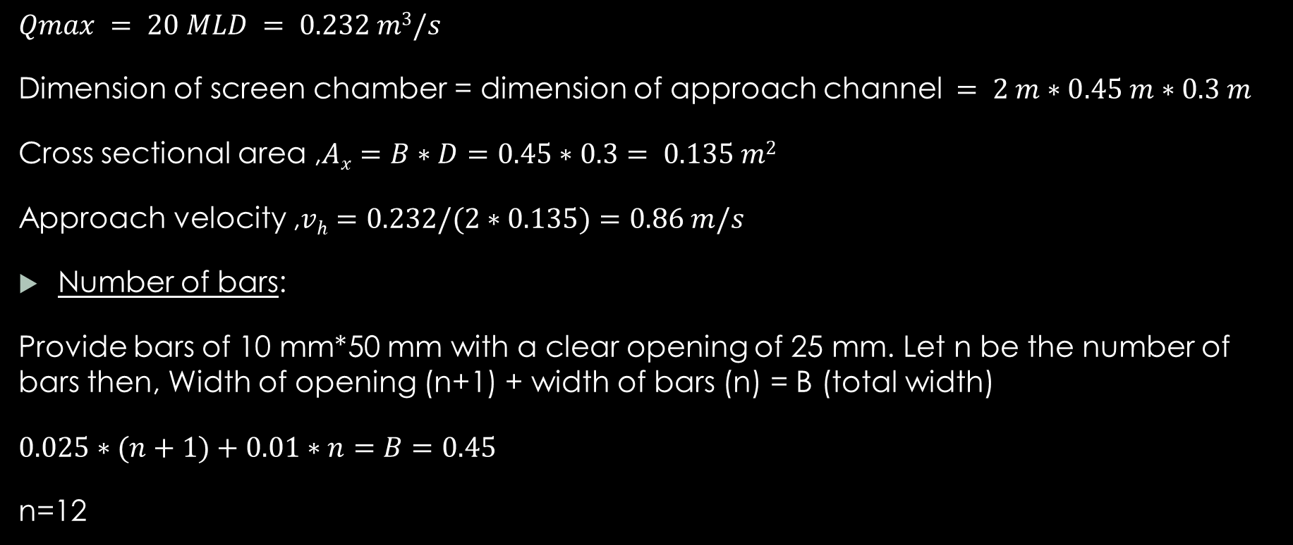
Design of Screen Chamber
$$Qmax = 20 MLD = 0.232 m3/s$$
Dimension of screen chamber = dimension of approach channel$= 2 m∗0.45 m∗0.3 m$
Cross sectional area ,$Ax=B∗D=0.45∗0.3= 0.135 m2$
Approach velocity ,$vh=0.232/(2∗0.135)=0.86 m/s$
Number of bars:
Provide bars of 10 mm*50 mm with a clear opening of 25 mm. Let n be the number of bars then, Width of opening (n+1) + width of bars (n) = B (total width)
$0.025∗(n+1)+0.01∗n=B=0.45$
n=12

Slide 24

Design of Screen Chamber
Provide 12 bars of 10 mm * 50 mm with clear spacing
Total width $=12∗0.01+13∗0.025=0.445 m$
Effective width of channel , $Be=0.45−12∗0.01=0.33 m$
Effective cross sectional area$,Be∗D=0.33∗0.3=0.099 m2$
Velocity of flow through screen bars , $v=\frac{flow}{(effective cross sectional area) }$
$$v=\frac{0.116}{0.1}=1.16 m/s \sim 1.2 m/s$$
Head loss , $hL=0.0729∗(v2−vh2)$
Here ,$hL=0.0729∗\left(1.22−0.862\right)=0.051 m$

Slide 25

Design of Screen Chamber
Assuming screening production as 0.0012 m³/ML of flow for 25 mm opening and a flow of 10 MLD for channel.
Quantity of screening produced $=0.0012∗12 =0.012 m3/d$(for 2 channel)
Cleaning can be done manually every 3 to 4 day from two channels.
Design of perforated plate:
Provide length of the plate equal to the total width of the chamber with position wall of 0.2 m thick , which is 1.1 m($0.45∗2+0.2$).
Assuming width of the plate equal to 0.3 m and depth of pocket equal to 0.2 m for collecting screenings.

Slide 26

Design of Screen Chamber
Capacity of the screening pocket , $C=1.1 ∗0.3 ∗ 0.2=0.066 m3$
Which is approximately equal to 3 days cleaning
Inclined length of bars, $\frac{D}{sin45°}=\frac{0.3+0.3(FB)}{sin45°}=0.85 m$
Horizontal projected length of bars $=0.85∗cos45°=0.6 m$
Let the length of the outlet zone be the width of the perforated plate $+ 0.2 m=0.3 m+0.2 m=0.5 m$
Assuming length of the inlet zone as 0.9 m, the total length of the screen channel is $0.9+0.6+0.5=2 m$
$⇒$Size of perforated plate $=0.45 m∗0.3 m$
$⇒$Screening collection pocket $=0.45 m∗0.3 m∗0.2 m$

Slide 27

Design of Grit Chamber
Assume no. of channels in one unit = 2
Detention time = 30 s
$$Qmax =20,000 m3/d$$
Max. flow per channel $=\frac{20000}{2}=10000 m3/d$
Vol. of each channel, $V=10000 m3/d∗\frac{30 s}{\frac{24hr}{d}∗\frac{60min}{hr}∗\frac{60s}{min}}=3.5 m3$
Assuming flow through velocity, $vh=0.2 m/s$
Length of each channel $=0.2∗30=6 m$
Cross sectional area of channel, $Ax=\frac{V}{L}=\frac{3.5}{6}=0.6 m2$
Assuming width of channel, B = 1 m, liquid depth in channel, $D=\frac{Ax}{B}=0.6 m$
Therefore, net dimensions $L=6 m, B=1 m, D=0.6 m$

Slide 28

Design of Grit Chamber
Check for surface loading rate: Surface area of channel, $As=6∗1=6 m2$
At Q_{peak}, $SLR=\frac{10,000}{6}=1666.67 m/d$ (within acceptable limits)
At Q_{avg} , $SLR=\frac{5000}{6}=833.33 m/d$
Therefore, the length and width are acceptable.
Adding 10% for each inlet and outlet zone $=6∗0.1∗2+6=7.2 m \sim 7.5 m$
And total width of the chamber with 2 channels including 0.2 m thick one partition wall and two side walls $=1+1+0.2+0.2+0.2=2.6 m$
Additional Depth is required to be provided for accumulation of grit in the chamber. Assuming grit accumulated to be 0.03 m³/1000 m³/d of flow and removal of grit is done at interval of 3 days, volume $=\frac{0.03∗10000∗3}{1000}=0.9 m3$
Therefore, the net depth of grit storage $=\frac{0.9}{6}=0.15 m$

Slide 29

Design of Grit Chamber
However provide the depth of 0.2 m for grit storage below the actual crest of weir.
Total Depth, $Dtotal=net depth+grit storage depth+freeboard\left(FB\right)=0.6+0.2+0.3$
$$Dtotal=1.1 m$$
And total liquid depth, $d=0.8 m$
Providing 2 channels, the overall dimensions of the grit chamber will be:
$$Ltotal=7.5 m$$
$$Btotal=2.6 m$$
$$Dtotal=1.1m (with 0.3 FB)$$
$$t=30 s$$

Slide 30

Design of UASB Reactor
Assumed temperature range = $22° to 28℃$ and the wastewater characteristics are of follows :
$$pH=7.3−7.7 BOD=350 mg/l$$
$$COD=820 mg/l sulphate=105 mg/l$$
$$TSS=395mg/l VSS= 270 mg/l$$
Raw sewage will be pumped to the inlet chamber at the top of the UASB floor of UASB kept at 3m below the GL.
Average flow $=10000 m3/d=0.116 m3/s$

Slide 31

Design of UASB Reactor
Sludge Production:
Assume BOD removal efficiency = $80 \%$(UASB effluent BOD $=70 mg/l$)
VSS produced in BOD removal $=0.1∗350∗0.8=28 mg/l$
Non – degradable residue =$VSS∗(1−0.4)=270∗0.6=162 mg/l$
Ash received in inflow $=TSS−VSS=395−270=125 mg/l$
Total sludge produced $=28+162+125=315 mg/l$

Slide 32

Design of UASB Reactor
SRT and HRT values:
$$SRT =\frac{total sludge in reactor }{sludge withdrawn per day}$$
Depth of sludge blanket $=2.2 m$, Effectiveness coefficient $=0.85$
Average conc. of sludge in blanket $=70 kg/m3$
Let full depth of reactor (including settler)$=5m$
$$SRT=30 days=\frac{\left(70\frac{kg}{m3}\right)\left(\frac{2.2}{5.0}\right)\left(0.85\right)\left(flow rate m3/d\right)\left( HRT\frac{hr}{24}\right)}{(322 kg /m3)(flow rate m3/d)}$$
$$HRT=\frac{30∗315}{(70)(2.2/5)(0.85)(\frac{1000}{24})}=8.66 hrs at average flow= 4.33 hrs at peak flow$$

Slide 33

Design of UASB Reactor
Upflow velocity:
Upflow velocity at avg. flow$=\frac{5 m}{8.66hrs}=0.577 m/hr$
We took $0.5 m/hr$(so that we are able to retain even flocculant sludge within UASB)
Upflow velocity at peak flow $=0.5∗2=1 m/hr$
Reactor dimensions:
Reactor area required = $\frac{ total flow m3/d}{upflow velocity, m/hr(24)}=\frac{10000}{0.5∗24}=833 m2$
Provide reactor of 35 m length, 24 m width and 5 m side water depth + 0.5 m freeboard.

Slide 34

Design of UASB Reactor
Check for organic loading: $Volumetric organic loading =\frac{\left(COD load\right)}{volume of reactor}$
$=\frac{820∗10000∗1000}{1000000∗(24∗35∗5)}=1.95 kg COD/m3/day$
Organic loading on sludge blanket $=\frac{820∗10000}{1000∗0.4(\frac{VSS}{TSS})70 kg/m3∗24∗35∗2.2}=0.158 kg COD/kg VSS/day$
COD Removed and Methane Produced:
Total COD removed = 80% of incoming load $=0.8∗(\frac{820}{1000})∗10000=6560 kg/day$
COD consumed in sulphate reduction:
Sulphate incoming $=105 mg/l$

Slide 35

Design of UASB Reactor
Assuming sulphate removal $=80\%=0.8∗105=84 mg/l=\frac{84 }{1000}∗10000=840 kg/day$
Corresponding COD consumed in sulphate reduction $=840∗0.67=562.8 kg/d$
COD available for methane production $=6560−562.8=5997.2 kg/d$
Methane produced at $27℃=350 l/kg COD removed$
Total methane produced/day $=5997.2∗0.350∗\frac{(273.15+27)}{273.15}=2306.5 m3/d$
Methane leaving as dissolved in effluent $=0.028∗10000=280 m3/day$
Usable methane $=2306.5−280=2026.5 m3/d=\frac{2026.5 m3/d}{6560 kg/d}=0.309 m3/ kg COD$

Slide 36

Design of UASB Reactor
Sulphates - Sulphides:
Sulphates contained in influent will be reduced to sulphides. Assuming 85% removal of sulphates and their reduction to sulphides,
$$S2− =0.85∗\frac{105}{3}=29.75 mg/l$$
$\frac{COD}{SO4}=\frac{820}{105}=7.8$(favourable)
Any H₂S gas present would be corrosive and would necessitate scrubbing of the gas with a NaOH solution prior to the supply of gas.
Residual sulphides remaining in the UASB, and therefore leaving in the effluent will have to be treated by aeration during post treatment.
Gas Collector Design:
Provide gas collector width (i.e. centre to centre distance between two deflector beams) of 4m. Hence number of gas collector $=\frac{24}{4}=6 no.$ (each 35 m length).

Slide 37

Design of UASB Reactor
Aperture Width:
Maximum upflow velocity through aperture is to be limited to 5 m/hr at peak flow.
Aperture area required $=\frac{peak flow m3/hr}{permissible aperture velocity m/hr}=\frac{10000∗2}{5∗24}=166.67 m2$
Aperture width $=\frac{aperture area}{length of aperture ∗ no. of aperture}=\frac{166.67}{35∗6}=0. 794 m$
Taking it as approximately equal to 0.8 m.

Slide 38

Design of UASB Reactor
Deflector Beam:
$$Width of deflector beam=aperture width+2(overlap)=0.8+2∗0.1=1 m$$
Height of deflector beam = 0.5 m
Check for total side water depth of 5m
Sludge bed height up to base of deflector beam$=2.2 m$
Collector plate height, P_{v} = 1.64 m
Vertical water depth in settler = 0.4 m
Free board at top$= 0.5 m$
Total reactor height $= 5.5 m$

Slide 39

Design of UASB Reactor
Settling Zone:
Cross sectional area of settler $=(0.8∗1.64)+(0.4∗3.2)+(1.64∗1.2)=4.56 m2$
$Volume=area∗length∗no.$ $=4.56∗35∗6=957.6 m3$
$HRT=\frac{volume}{flow rate}=\frac{957.6}{10000m3/d(\frac{1}{24})}=2.3 hrs$(acceptable)
$Surface loading=\frac{10000 m3/d }{settler width∗length∗no. }=\frac{10000}{3.2∗35∗6}=14.88 m3/m2/day$(acceptable)
Final effluent should be suitable for land irrigation (BOD<100 mg/l, SS < 100 mg/l, Sulphide < 2 mg/l)

Slide 40
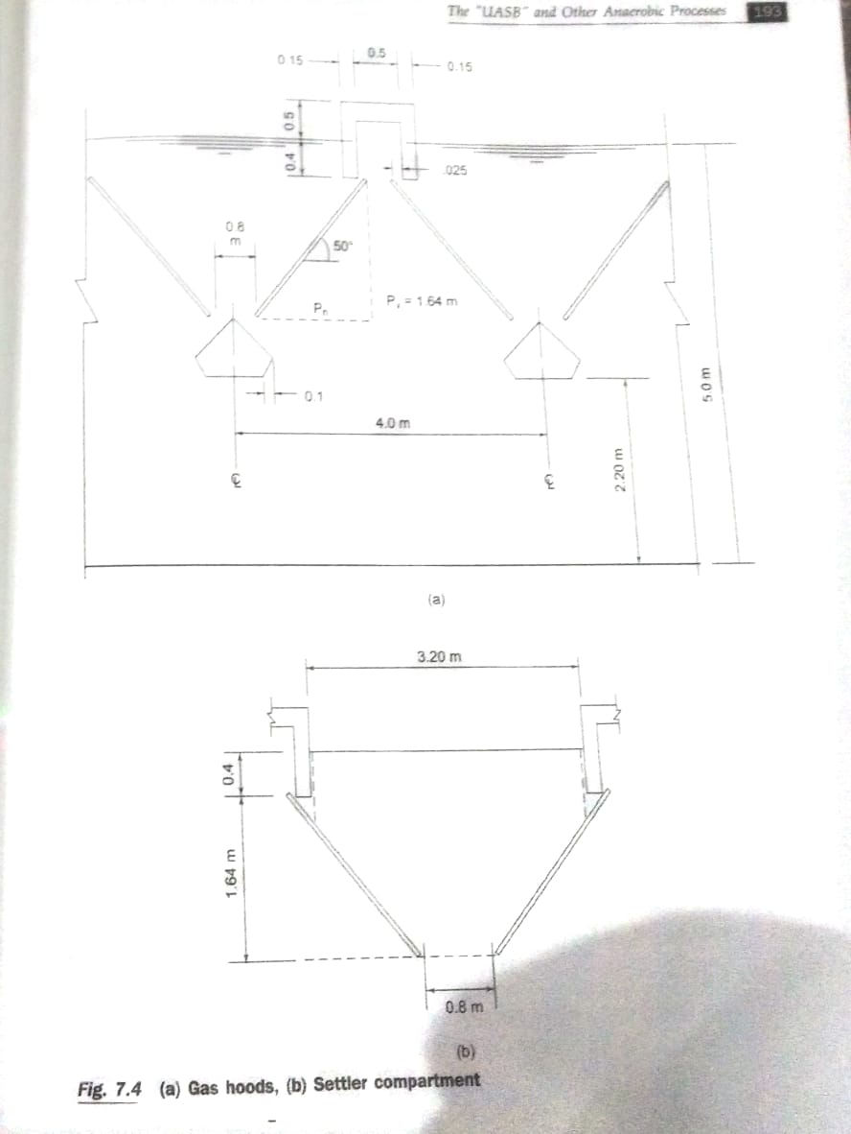
Design of UASB Reactor

Slide 41

Design of UASB Reactor
Sludge Withdrawal and Dewatering:
Sludge produced $=315 mg/l=0.315 kg/m3$
At a sludge concentration of 7 % solids , the sludge volume $=\frac{3150}{0.07}= 45 m3/d$
Sludge Drying Bed
Sludge drying time of 7 days followed by 2 to 3 days for sludge lifting before the next cycle commences, and assuming 45 m³/d will be applies at 25 cm depth
Total sludge bed area required $=45∗\frac{10}{0.25 m}=1800 m2$
Provide 12 beds of length 15 m and width 10 m. The beds will be formed with graded gravel and sand with open-jointed, glazed stoneware pipes at bottom to drain the filtrate back to the plant.

Slide 42

Design of Facultative Type Aerated Lagoon
Provide facultative aerated lagoon of 1 day detention time
BOD removal will occur from 70 mg/l to 40 mg/l (i.e. 42.8 % removal)
Oxygen demand $=0.428 (incoming BOD ultimate)=0.428 (1.47 ∗70 gm/m3 ∗ 10000∗(1/1000)=440 kg/d =18.3 kg/h$
Also oxygen demand of 20 mg/l sulphides $=20∗2=40 mg oxygen/litre$
Kilogram of solids deposited from carryover @ 200 mg/l for ½ hour = 41.6 kg (oxygen demand @ 0.1 kg oxygen/kg solids = 4.16 kg oxygen/day $=0.17 kg / hr$)
Total oxygen required $=18.3 kg/hr+16.7 kg/hr+0.17=35.2 kg/hr$
Power level $=2.51 W/m2$

Slide 43
References
Waste water treatment by G.L. Karia and R. A. Christian
CPHEEO manuals
Wikipedia

Slide 44
Thank You

